Slide 1

Business Continuity Systems (Data Recovery Systems)
CS 591 Course Project
Team #06
Nagendra Gangupamu - Class ID = 11
Sai Venkata Nikhil - Class ID = 17
Vega Patel - Class ID = 13

Slide 2
Index
Contents | Page No
Introduction | 3-4
Software Design and Development Model | 5
Scope Requirements | 6-14
Human Resource Management Plan | 15
Project Cost Estimates | 16-17
Time Management Plan | 18-25
Cost Management Plan | 26-29
Risk Management Plan | 30-36
Procurement Management Plan | 37-38
Statement of Work | 39-40
Request for Proposal | 41
Request for Quote | 42
Conclusion

Slide 3
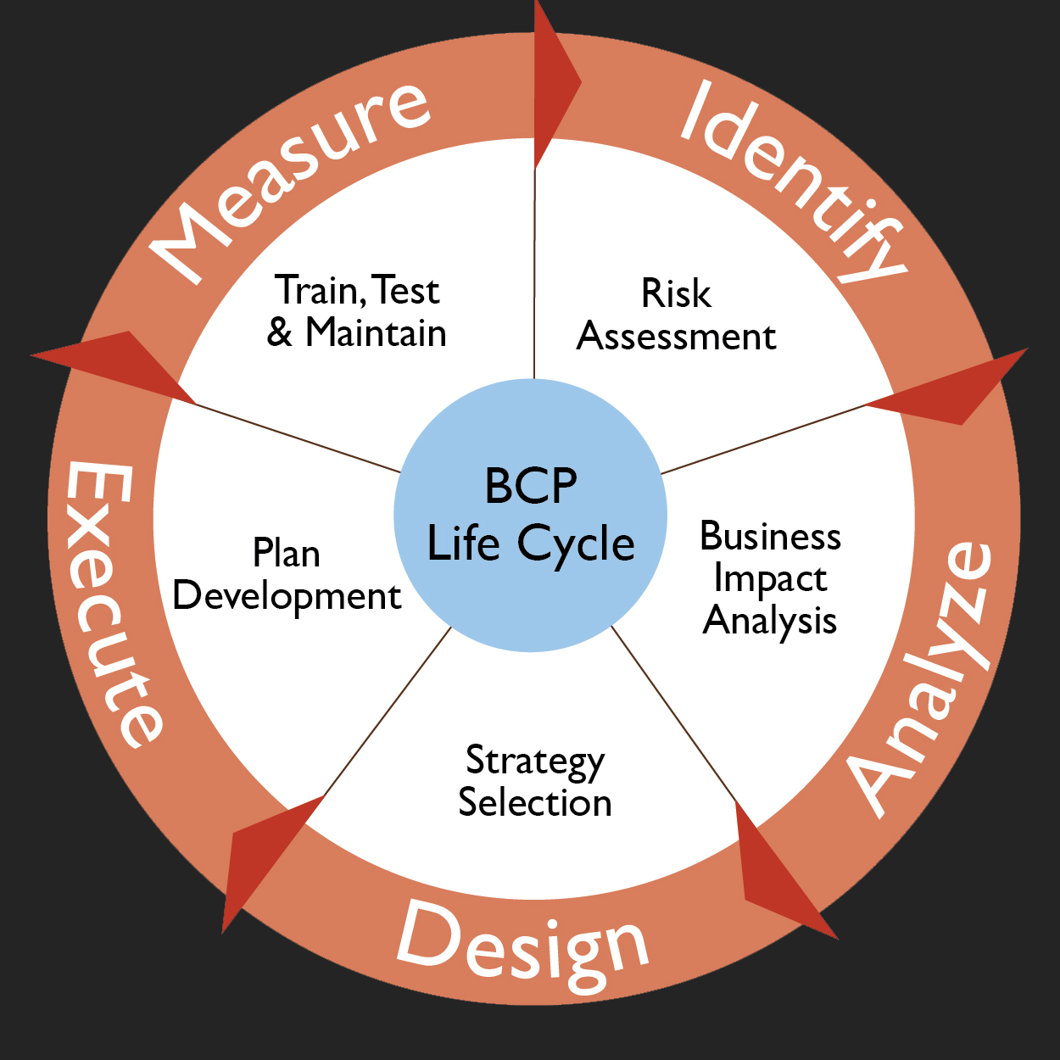
Business Continuity
Introduction:
Planning to ensure the continuation of operations in the event of a catastrophic event.
Business continuity planning goes beyond disaster recovery planning to include:
• The actions to be taken
• Resources required, and
• Procedures to be followed to ensure the availability of essential services, programs, and operations in the event of unanticipated interruptions.

Slide 4
Comparison Table
System | eVault | Clearview | Storix | Datto | BCMfort
Main Functions | Authentication Backup Management Controlled Data Access Encryption | Reporting Integration Management Programme Management Offsite Recovery | Adaptable System Recovery Data Cloning Backup Management Disaster Recovery | Data Protection Virtualization Centralized Management Security | Risk Assessment Cost Effective Control Management Security
Scope | End-to-end encryption keeps confidential data safe at every step, and flexible deployment options protect complex, multi-platform sites and distributed networks. With simple pricing and dedicated business support | Clear View represents Making the Complicated Simple of BCM platform which is rapidly being adopted world-wide. Modern yet proven, it helps clients comply with BCM best practice while facing the inevitable need for greater cost-efficiencies | Storix, Inc., providers of disaster recovery solutions for Linux and Unix systems.Storix SBAdmin was one of the first enterprise applications to provide support for Linux on IBM Power systems. | From virtual cloud data to physical endpoint files and the systems that process it all, our total data protection makes your business invincible, secure, and instantly restorable. | BCMfort can ensure that your organization takes a proactive stance to risk management by having controls in place to properly recognize, record and reduce its risk.
Programming Languages used | Java | C# , JAVA | Java | ABAP, Java, C++ | Java , C++
Total Lines of code | 1 Million | 119K | 102K | 334K | 80.5K
Technical Platform | OS: Windows Linux, | .OS: Windows | OS: AIX, Windows Linux, | OS: Windows, Unix | OS: Windows Linux,
 | Server: Apache Server | Server: Apache Server | Server: Apache Server | Server: Tomcat Server | Server: Apache Server
 | DB: mysql Server | DB: mysql Server | DB: mysql Server | DB: mysql ServerNet Server 3.0 | DB: MySQL Server
Website for downloadable version of trial software | https://www.evault.com/platform/technologies/ | http://www.clearview-continuity.com/ | http://www.storix.com/sbadmin-support/free-trial | http://www.datto.com/technologies/backup-insights | https://bcmfort.com/services/

Slide 5
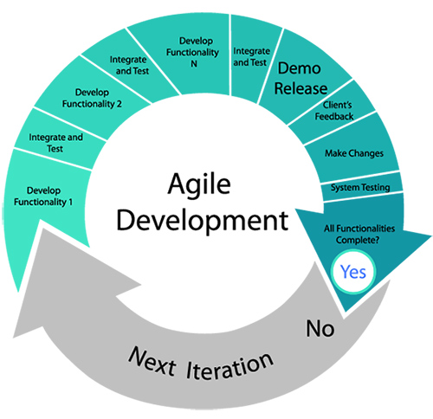
Software Design and Development Model

Slide 6
Business Continuity Planning Scope
Functional Requirements :
• Business Rules • Transaction Requirements • Administrative Functions • Authentication • Authorization Levels • Reporting Requirements • Audit Tracking • External Interfaces • Risk Evaluation • Business Impact Analysis • Recovery Strategy • Testing and Maintenance

Slide 7
Business Continuity Planning Scope (cont.)
Non-Functional Requirements:
Availability: 99.999% uptime
Scalability: Easily scalable to over 10,000 users and over 2,000,000 records
Recoverability: Ability to restore your deployment to the point at which a failure occurred.
Backups: We should be able to download full database backups on a daily basis
Disaster Recovery: Redundant data centers needed to minimize impact of disaster upon information and data required for critical business processes.

Slide 8
Business Continuity Planning Scope (cont.)
Technical Platform:
Web Server: Apache Server
Database: MySQL
Operating System: Windows, Unix, Linux.
Language: Built on J2EE Framework, JAVA.

Slide 9
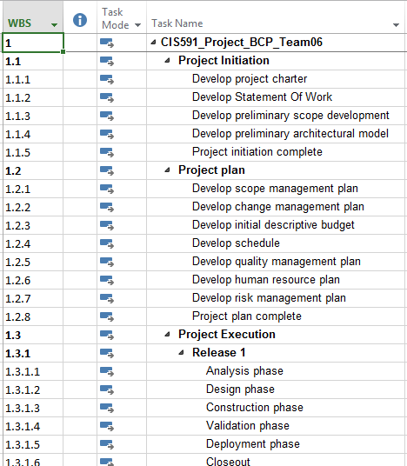
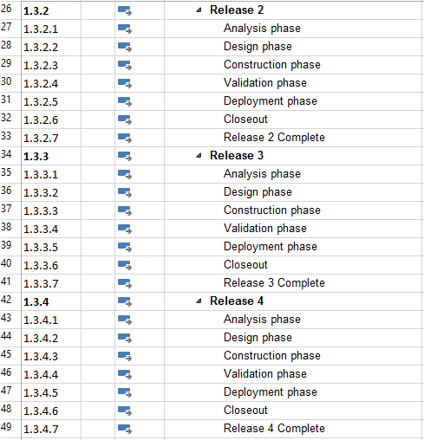
Work Breakdown Structure

Slide 10
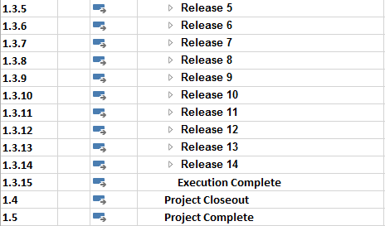
Work Breakdown Structure

Slide 11
Roles and Responsibility Matrix
Activity | Quality Manager | Project Manager 1 | Project Manager2 | Project Manager 3 | Project Manager4 | System Analyst1 | System Analyst 2 | System Analyst 3 | System Analyst 4 | System Analyst 5 | Developer1 | Developer2 | Developer3 | Developer4
1
1.1
1.1.1 |  | A | R | R |  |  |  | I |  | I |  |  | I
1.1.2 |  | A | R | R |  |  |  |  |  |  | I | I | I | I
1.1.3 |  | R | R | A |  | R |  |  |  |  | I | I | I | I
1.1.4 |  | A | R | R | C | R |  |  | ] |  | I | I | I | I
1.1.5 | A | R | R | R | R | I | I | I | I | I | I | I | I | I
1.2 |  | A | C | R |  | I | I | I | I | I | I | I | I | I
1.2.1 |  | A |  | R | I |  | I | I | I | I | I | I | I | I
1.2.2 |  | R | A |  |  | R | R | I | I | I | I | I | I | I
1.2.3 |  | R | R | A | I | R | R | I | I | I | I | I | I | I
1.2.4 |  | A | C | R | C |  | R | R | R |  | I | I | I | I
1.2.5 |  | R | A |  | R |  | R | R |  |  | I | I | I | I
1.2.6 |  | A | C | R | I | R | C | R |  | R | I | I | I | I
1.2.7 |  | A | R |  | C | R | R | R | I | I | I | I | I | I
1.2.8 | A | R | R | R | R | C | C | I | I | I | I | I | I | I
1.3 |  | C | C |  | C | C | C | C | I | I | I | I | I | I
1.3.1 |  | R | A |  |  | R | R | C | I | I | I | I | I | I
1.3.1.1 |  | A | R | C | R | R | C | R | I | I | I | I | I | I
1.3.1.2 |  | R | A |  | I | R | R | R |  |  | R | R | R | R

Slide 12
Roles and Responsibility Matrix
Activity | Quality Manager | Project Manager 1 | Project Manager2 | Project Manager 3 | Project Manager4 | System Analyst1 | System Analyst 2 | System Analyst 3 | System Analyst 4 | System Analyst 5 | Developer1 | Developer2 | Developer3 | Developer4
1.3.1.3 |  | R | C |  |  | I | R | I |  |  | I | R | R
1.3.1.4 |  | A |  |  |  | I | I | I |  |  | I | R | I
1.3.1.5 |  |  |  |  |  |  |  | R | R |  |  |  | R
1.3.1.6 |  | A |  | R |  |  |  |  |  |  | I | I | R | R
1.3.1.7 | A | R |  | R |  |  |  | R |  |  | I | I | I
1.3.2 |  | R | A |  |  |  |  |  | R |  | I | I | I
1.3.2.1 |  |  |  |  |  | R | I | I |  |  | R | I | I
1.3.2.2 |  | C | R | A |  | I | I | I |  | R | R | R | R | R
1.3.2.3 |  | C |  |  |  |  | R | I |  |  | I | R | R
1.3.2.4 |  | A | R | R |  | R | R | I | I |  | I | R | I
1.3.2.5 |  |  | C |  | R |  |  | R | R |  | I | I | R
1.3.2.6 |  | C | A |  | R |  |  | R | R | R | R | I | I
1.3.2.7 | A | R | C | R |  |  | R | R |  |  | I | I | I
1.3.3 |  | C | C |  |  | R | C | R |  | R | I | I | I
1.3.3.1 |  | A |  | R |  | R | I | I |  |  | R | I | I
1.3.3.2 |  | C | R |  |  | I | I | I |  |  | R | R | R | R
1.3.3.3 |  |  |  |  |  |  | R | I |  |  | I | R | R
1.3.3.4 |  | C | C |  |  | R | R | I |  |  | I | R | I
1.3.3.5 |  |  | A |  | R |  |  | R | R |  | I | I | R
1.3.3.6 |  | C | C |  |  |  |  | R | R | R | R | I | I
1.3.3.7 | A | R |  | R |  |  | R | R |  |  | I | I | I

Slide 13
Roles and Responsibility Matrix
Activity | Quality Manager | Project Manager 1 | Project Manager2 | Project Manager 3 | Project Manager4 | System Analyst1 | System Analyst 2 | System Analyst 3 | System Analyst 4 | System Analyst 5 | Developer1 | Developer2 | Developer3 | Developer4
1.3.14 |  | R | C |  |  | I | I | I |  |  | I | I | I
1.3.14.1 |  | A |  | R |  | R | I | I |  |  | R | I | I
1.3.14.2 |  | C | R |  |  | I | I | I |  |  | R | R | R | R
1.3.14.3 |  | R |  | C |  |  | R | I | I |  | I | R | R
1.3.14.4 |  | C | C |  | A | R | R | I |  |  | I | R | I
1.3.14.5 |  | A | A |  |  |  |  | R | R |  | I | I | R
1.3.14.6 |  | C | C |  |  |  |  | R | R | R | R | I | I | I
1.3.14.7 | A | R |  | R | C |  | R | R |  |  | I | I | I
1.3.15 |  |  |  | R |  |  | I | I |  |  | I | I | I
1.4 |  | C | R | R |  |  |  | I |  |  | I | I | I | I
1.5 | A | R | R |  | C |  |  | I | I |  | I | I | I

Slide 14
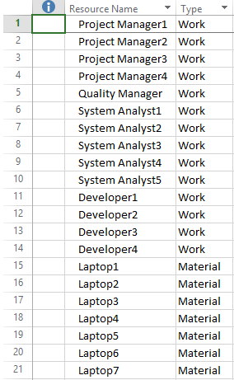
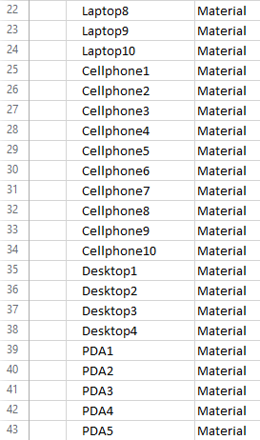
Required Resources

Slide 15
Required Human Resources
S.No | Job Title | Resources
1 | Quality Manager | Laptop5, Cellphone5, PDA5
2 | Project Manager1 | Laptop1,Cellphone1,PDA1
3 | Project Manager2 | Laptop2,Cellphone2, PDA2
4 | Project Manager3 | Laptop3,Cellphone3, PDA3
5 | Project Manager4 | Laptop4,Cellphone4, PDA4
6 | System Analyst1 | Laptop6,Cellphone6
7 | System Analyst2 | Laptop7,Cellphone7
8 | System Analyst3 | Laptop8,Cellphone8
9 | System Analyst4 | Laptop9,Cellphone9
10 | System Analyst5 | Laptop10,Cellphone10
11 | Developer1 | Desktop1
12 | Developer2 | Desktop2
13 | Developer3 | Desktop3
14 | Developer4 | Desktop4

Slide 16
Cost Estimates – LOC Based Estimation
Function | Pages | Lines of Code Per Page | Total Lines of Code(TLOC)
User Interface for Static Pages | 51 | 327 | 16677
User Interface for Dynamic Pages | 47 | 297 | 13959
Code Behind Static Pages | 81 | 222 | 17982
Code Behind Dynamic Pages | 85 | 311 | 26435
Database- SQL Stored Procedures | 34 | 291 | 9894
Business Layer-Logical Pages | 21 | 228 | 4788
Other Layer-Logical Pages | 17 | 115 | 1955
 |  | Total | 91690
Estimating $12 per line of code |  | Total Project Cost | 1,100,280

Slide 17
FP Based Estimation
Category | Low | Weight_L | Average | Weight_A | High | Weight_H | Total (T)
User inputs | 21 | 3 | 10 | 5 | 5 | 4 | 133
User outputs | 13 | 3 | 15 | 8 | 7 | 8 | 241
User inquires | 15 | 4 | 13 | 3 | 9 | 4 | 135
File/Structures | 16 | 7 | 12 | 5 | 8 | 5 | 212
External Interface | 10 | 6 | 14 | 5 | 5 | 9 | 175
Unadjusted Total (UT): |  |  |  |  |  |  | 896
Total Functional points = 896
Average Cost per functional point is 1230
Estimated Project Cost= 896*1230 = $1,102,080

Slide 18
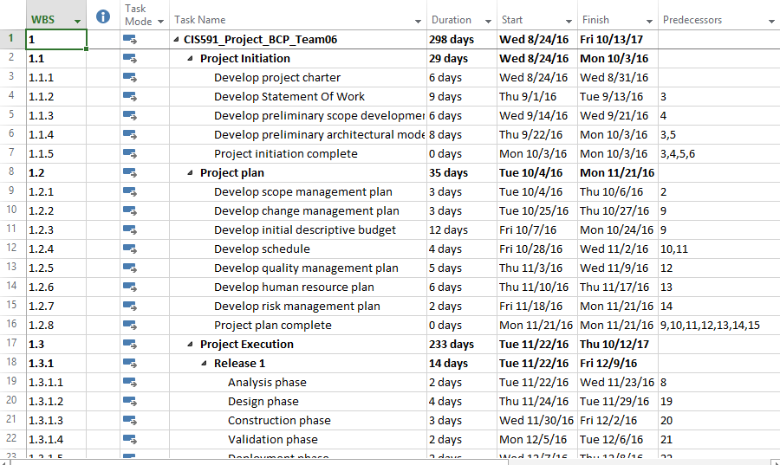
Time Management Plan – Project tasks

Slide 19
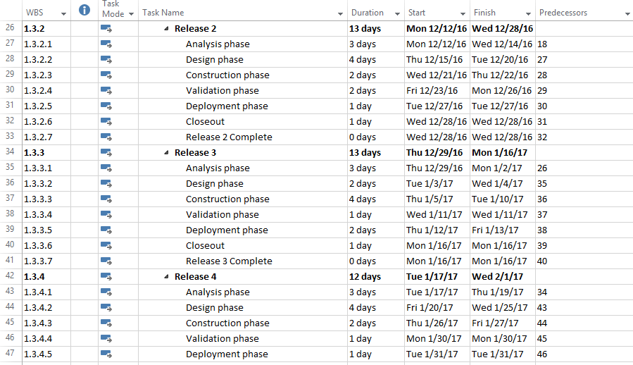
Time Management Plan – Project tasks (Cont.)

Slide 20
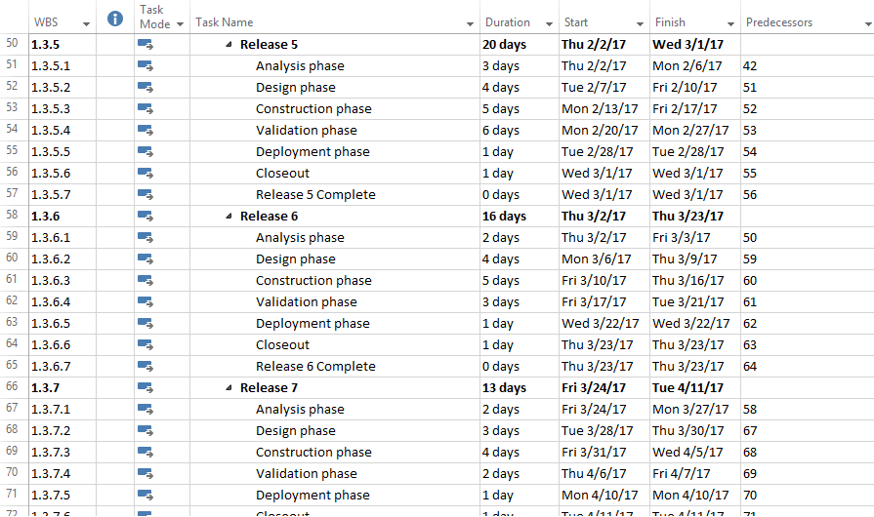
Time Management Plan – Project tasks (Cont.)

Slide 21
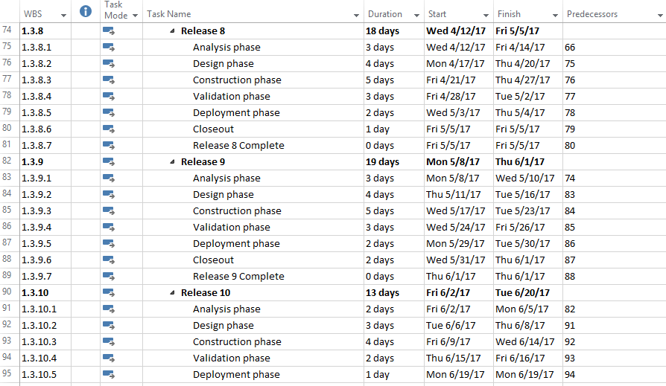
Time Management Plan – Project tasks (Cont.)

Slide 22
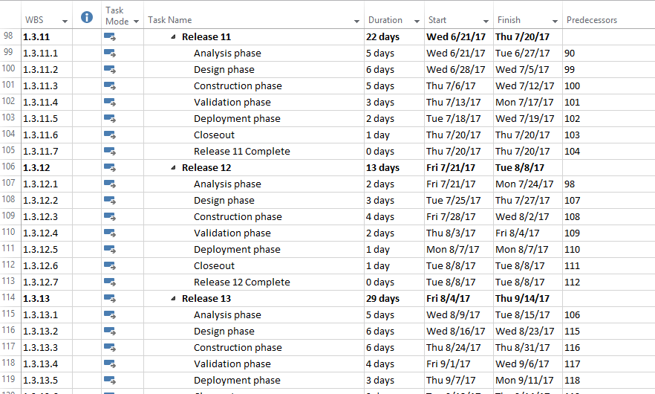
Time Management Plan – Project tasks (Cont.)

Slide 23
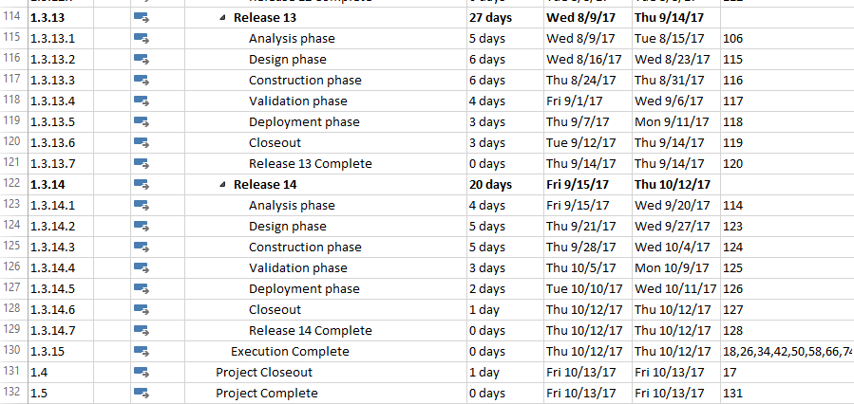
Time Management Plan – Project tasks (Cont.)

Slide 24
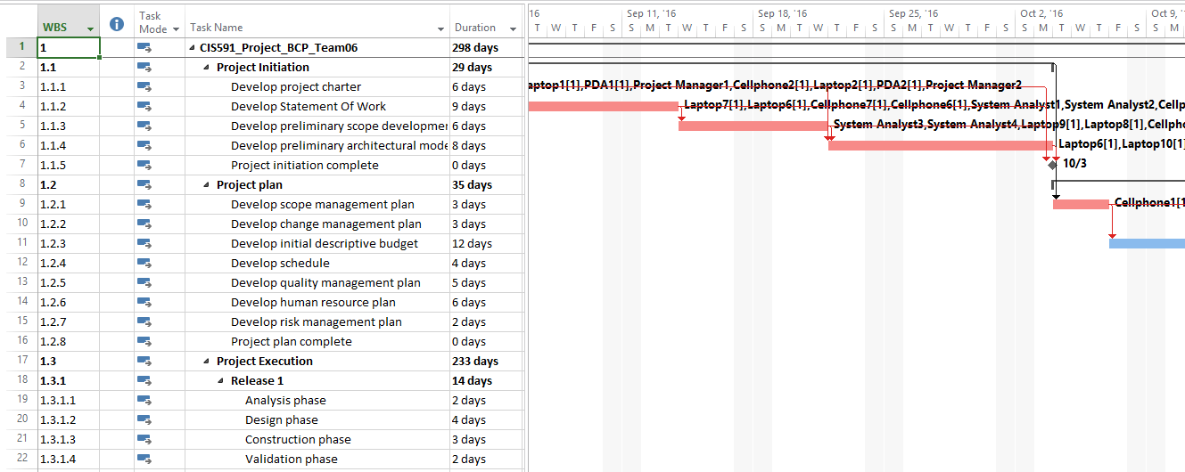
Time Management Plan – Gantt Chart

Slide 25
Time Management Plan
Phases | Start Date | Final Date | Duration(Days)
1.1 Project Initiation | 8/24/2016 | 10/3/2016 | 29
1.2 Project Plan | 10/4/2016 | 11/21/2016 | 35
1.3.1 Release 1 | 11/22/2016 | 12/9/2016 | 14
1.3.2 Release 2 | 12/12/2016 | 12/28/2016 | 13
1.3.3 Release 3 | 12/29/2016 | 1/16/2017 | 13
1.3.4 Release 4 | 1/17/2017 | 2/1/2017 | 12
1.3.5 Release 5 | 2/2/2017 | 3/1/2017 | 20
1.3.6 Release 6 | 3/2/2017 | 3/23/2017 | 16
1.3.7 Release 7 | 3/24/2017 | 4/11/2017 | 13
1.3.8 Release 8 | 4/12/2017 | 5/5/2017 | 18
1.3.9 Release 9 | 5/8/2017 | 6/1/2017 | 19
1.3.10 Release 10 | 6/2/2017 | 6/20/2017 | 13
1.3.11 Release 11 | 6/21/2017 | 7/20/2017 | 22
1.3.12 Release 12 | 7/21/2017 | 8/8/2017 | 13
1.3.13 Release 13 | 8/9/2017 | 9/14/2017 | 27
1.3.14 Release 14 | 9/15/2017 | 10/12/2017 | 20
Overall Project | 8/24/2016 | 10/13/2017 | 298

Slide 26
Cost Management Plan
Resource Name | Type | Initials | Max. Units | Std. Rate
Quality Manager | Work | P | 100% | 64.12$/hr
Project Manager1 | Work | P | 100% | 68.56$/hr
Project Manager2 | Work | P | 100% | 61.20$/hr
Project Manager3 | Work | P | 100% | 59.32$/hr
Project Manager4 | Work | P | 100% | 62.30$/hr
System Analyst1 | Work | S | 100% | 56.35$/hr
System Analyst2 | Work | S | 100% | 52.16$/hr
System Analyst3 | Work | S | 100% | 47.23$/hr
System Analyst4 | Work | S | 100% | 49.21$/hr
System Analyst5 | Work | S | 100% | 55.65$/hr
Developer1 | Work | D | 100% | 47.32$/hr
Developer2 | Work | D | 100% | 46.89$/hr
Developer3 | Work | D | 100% | 50.19$/hr
Developer4 | Work | D | 100% | 53.67$/hr

Slide 27
Cost Management Plan – Material Resources
Resource Name | Type | Initials | Std. Rate
Laptop1 | Material | L | 2200$
Laptop2 | Material | L | 2200$
Laptop3 | Material | L | 2200$
Laptop4 | Material | L | 2200$
Laptop5 | Material | L | 2200$
Laptop6 | Material | L | 2000$
Laptop7 | Material | L | 2000$
Laptop8 | Material | L | 2000$
Laptop9 | Material | L | 2000$
Laptop10 | Material | L | 2000$
Desktop1 | Material | D | 1500$
Desktop2 | Material | D | 1500$
Desktop3 | Material | D | 1200$

Slide 28
Cost Management Plan – Material Resources
Resource Name | Type | Initials | Std. Rate
Desktop4 | Material | D | 1200$
Cellphone1 | Material | C | 200$
Cellphone2 | Material | C | 170$
Cellphone3 | Material | C | 150$
Cellphone4 | Material | C | 150$
Cellphone5 | Material | C | 120$
Cellphone6 | Material | C | 100$
Cellphone7 | Material | C | 150$
Cellphone8 | Material | C | 80$
Cellphone9 | Material | C | 80$
Cellphone10 | Material | C | 200$
PDA1 | Material | P | 200$
PDA2 | Material | P | 200$
PDA3 | Material | P | 150$
PDA4 | Material | P | 150$
PDA5 | Material | P | 170$

Slide 29
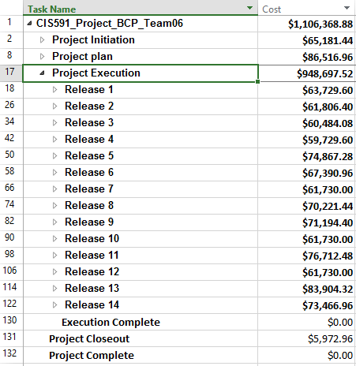
Cost Management Plan – Material Resources
Task# | Task Name | Estimated Budget
1 | Project Initiation | $65,181.44
2 | Project Plan | $86,516.96
3 | Release1 | $63,729.60
4 | Release2 | $61,806.40
5 | Release3 | $60,484.08
6 | Release4 | $59,729.60
7 | Release5 | $74,867.28
8 | Release6 | $67,390.96
9 | Release7 | $61,730.00
10 | Release8 | $70,221.44
11 | Release9 | $71,194.40
12 | Release10 | $61,730.00
13 | Release11 | $76,712.48
14 | Release12 | $61,730.00
15 | Release13 | $83,904.32
16 | Release14 | $73,466.96
17 | Project Closeout | $5,972.96
 | Total Cost | $1,106,368.88

Slide 30
Risk Management Plan – Decision Tree
Initial Question
Options
Probabilities
Outcomes
Expected Values
$1,065,093.84
$1,065,093.84*0.4 = $426,037.53
CF = 0.4
In house development
PS = 0.25
$1,174,334.32
$1,174,334.32*0.25 = $293,583.58
CS = 0.35
$1,106,368.88
$1,106,368.88*0.35 = $387,229.1
Key piece of software
Total = $254,775.15
CF = 0.6
$1,065,093.84
$1,065,093.84*0.6 = $639,056.3
outsource
CS = 0.4
$1,142,696.23
$1,142,696.23*0.4 = $457,078.49
Total = $181,977.8

Slide 31
Risks in Business Continuity

Slide 32
Risks in Business Continuity

Slide 33
Risk Management Plan – Risk Exposure Table
Risk No. | Risk Drivers | Description | Risk Probability (RP) | Risk Impact (RI) | Risk Exposure (RP * RI)
1 | Experience and Teaming | Limited software experience in the project office. Software staff not included in early planning and design decisions. | Medium(0.5) | Medium High(0.7) | 0.35
2 | Requirements and Design | Systems decisions made without accounting for impact on software. Poor scope definition. | High(0.9) | High(0.9) | 0.81
3 | Planning | Lack of appropriate planning detail with insufficient reviews. Unclear SOW and WBS. | Medium Low(0.3) | Medium Low(0.3) | 0.09
4 | Testing | Plan to convert SW test documents not due till very late in the life-cycle.developers into test team late in life-cycle. | Medium High(0.7) | Medium High(0.7) | 0.49
5 | Tools | Limited test analysis tools. Unproven design tools selected with limited time for analysis. | Low(0.1) | Medium Low(0.3) | 0.03
6 | Schedule | Schedule changes - with the possibility of scope changes and other issues, schedule changes may also be needed. | Medium High(0.7) | Medium Low(0.3) | 0.21

Slide 34
Risk Management Plan – Probability Matrix
IMPACT | LOW | LOW MEDIUM | MEDIUM | MEDIUM HIGH | HIGH
PROBABILITY
LOW |  | 3
LOW MEDIUM |  |  | 2
MEDIUM | 4
MEDIUM HIGH |  |  |  | 1
HIGH |  |  | 5 | 6 | 7
 | IMPACT | PROBABILITY
1.Key piece of code construction outsourced | Medium high | Medium high
2.Budget constraints | Medium | Medium Low
3.Poorly understood requirements | Medium low | Low
4.Change Management | Low | Medium
5.Some Key Users Located in a different location from IT staff | Medium | High
6.Technology used for development is new to IT staff | Medium high | High
7.Project manager assigned to project is new to the company | High | High

Slide 35
Risk Management Plan
Case # | Project Total Cost | Risk Factor | Duration (Days) | Probability | Expected Value
 | (Data will be obtained during Lab 3) | (Data must be calculated before the Lab 3) | (Data will be obtained during Lab 3) | (Data will be given by Instructor before Lab 3) | (Data will be calculated during Lab 3)
0 | $1,106,368.88 | 1.62 | 298
1 (Remove 1 expert (8-9 yrs exp) - 1SA) | $1,093,152.88 | 1.9 | 298 | Partial Failure (35%) | ($4,625.60)
2 (Remove 2 experts(8-9 yrs exp) 1SA, 1 Devloper) | $1,065,093.84 | 2.2 | 310.67 | Complete Failure (30%) | ($12,382.51)
3 (add experts - 1tester, 1developer) | $1,142,696.23 | 0.94 | 289.67 | Complete Success (20%) | $7,265.47
4(add beginners - 1PM, 1SA, 1tester, 1 developer) | $1,174,334.32 | 1.28 | 282.07 | Partial Success (15%) | $10,194.82
 |  |  |  | EMV | $452.17
 |  |  |  | Total EMV | $1,106,821.05
 |  |  |  |  | So from a risk perspective, this project is worth doing.

Slide 36
Risk Management Plan- Risk Factors and Graphs

Slide 37
Procurement Management – Make Or Buy Diagram
904369
542621.4
515739.2
Expected cost for build:
542621.4+515739.2
=$1058360.6
0.6
1289348
Build
0.4
1098454
659072.4
456187.6
Expected cost for Reuse:
659072.4+456187.6
=$1115260
0.4
Reuse
0.6
BCP SYSTEM
1140469
Buy
0.7
1194172
358251.56
886269.2
Expected cost for Buy:
358251.56+886269.2
=$1244520.76
0.3
1266098
Contract
0.35
1179279
412747.95
834821.5
Expected cost for Contract: 412747.95+834821.5
=$1247569.45
0.65
1284340

Slide 38
Procurement Management Plan
If Project is Completed by Seller at $1,106,368.88
If Project Completed by Seller at $1,156,368.88
Sharing formula : 80/20
Allowable cost: $1,120,000
Maximum Fee: $80,000
Minimum Fee: $20,000
Target fee : $50,000
Computations:
$1,106,368.88 +[$1,120,000- $ 1,106,368.88]*0.20+50,000 = $1,159,095.1
Profit: $52,726.2
Sharing formula : 80/20
Allowable cost: $1,120,000
Maximum Fee: $80,000
Minimum Fee: $20,000
Target fee : $50,000
Computations:
$1,156,368.88 + $20,000 = $1,176,368.88
Profit: $20,000

Slide 39
Statement of Work
Project Name: Business Continuity Planning
Customer: IT Organization
Project Start Time: Wed 08/24/16
Project End Time: Fri 10/13/17
Project Implementation Estimates:
Project Initiation: Wed 8/24/16 to Mon 10/3/16
Project Plan: Tue 10/4/16 to Mon 11/21/16
Release1: Tue 11/22/16 to Fri 12/9/16
Release 2: Mon 12/12/16 to Wed 12/28/16
Release 3: Thu 12/29/16 to Mon 1/16/17
Release 4: Tue 1/17/17 to Wed 2/1/17
Release 5: Thu 2/2/17 to Wed 3/1/17
Release 6: Thu 3/2/17 to Thu 3/23/17
Release 7: Fri 3/24/17 to Tue 4/11/17
Release 8: Wed 4/12/17 to Fri 5/5/17
Release 9: Mon 5/8/17 to Thu 6/1/17
Release 10: Fri 6/2/17 to Tue 6/20/17
Release 11: Wed 6/21/17 to Thu 7/20/17
Release 12: Fri 7/21/17 to Tue 8/8/17
Release 13: Fri 8/4/17 to Wed 9/13/17
Release 14: Thu 9/14/17 to Wed 10/11/17

Slide 40
Statement of Work(cont.)
Project Description: Business Continuity Planning (BCP) is a structured framework for identifying the risk posed to an organization via internal and external threats
Goal: BCP should be able to provide a shield and protect the organization from threats such as natural disasters or data breaches and also the business interests of the Organization.
Objective: Analyzing and understanding continuity needs and establishing realistic business continuity planning policies. Implementation of controls and measures to manage overall continuity risks of an organization.
Operating, Monitoring and performance evaluation of business continuity planning system.
Phases Of Work: Pre-Evaluation Screening, Planning Phase, Testing, End-user Training, Post-Implementation

Slide 41
Request for Proposal
Background: Team_06_CS591 is developing BCP system. The validation is outsourced to eligible agency. The solely purpose of the document is to request a quote for the execution of validation phase of BCP system software development.
Objective: The objective to obtain statement of work for validation test for BCP system.
Schedule: Bids shall be firm offers and shall remain valid for acceptance 60 days following the RFQ closing date. RFQ closing date – October 13, 2017
Statement of work: Detailed enclosed in Statement of work
Technology Constraints: Detailed enclosed in Statement of work
Evaluation Criteria:
Contract award in best interest Team_06_CS591 reserves the right to accept or reject proposal on each item separately or as a whole. The team also reserves the right to award any resultant contract as a whole, or split award between bidders.
Bid Rejections Failure to use the bid form furnished by our team Failure to sign the bid by authorized representatives.
Late or incomplete bid.
Contract award Team_06_CS591 reserve the right to negotiate modification of the bid prices, terms and conditions with lowest responsive bidder.
Vendor: The Vendor shall provide three references to contract for further processes.
Evaluation Criteria Each RFQ response will be evaluated on the bases of the following criteria list in order of importance:
Based on experience, cost and time.

Slide 42
Request For Quote
Item | Description | Unit Cost | Extended Cost
1 | Unit Test case design, test script, results, supporting document and traceability of software design.
2 | Software integration test design, test case, results, supporting documentations and traceability to software design
3 | System integration test design, test case, results and supporting documentations traceability to high level system requirements.
Send completed bids to:
Team_06_CS591
Bradley University,
Peoria, IL, 61625
Additional Information contact:
BCP Support
Bradley University,
Peoria, IL, 61625

Slide 43
Thank You !

